Slide 1
2018 Washtenaw County Opioid Summit
Engagement &
Motivational Interviewing (MI)
Anna Byberg, LMSW, CAADC

Slide 2
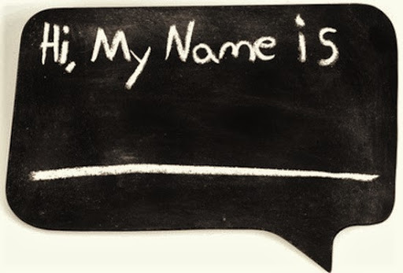
Intro

Slide 3
Agenda
Engagement
Hope
Ambivalence
MI OARS
MI Spirit
Recovery Capital
BPS
Therapeutic Alliance
Q&A

Slide 4
Engagement
Competing interests
Collecting information
Developing rapport
Time constraints
First needs first (water?)
(Chris)

Slide 5
“If you want to treat an illness that has no easy cure, first of all, treat them with hope.”
George Vaillant

Slide 6
Hope
If there was just one thing
Complicated, holistic, individualized
Accumulating positive experiences
(unicorns)

Slide 7
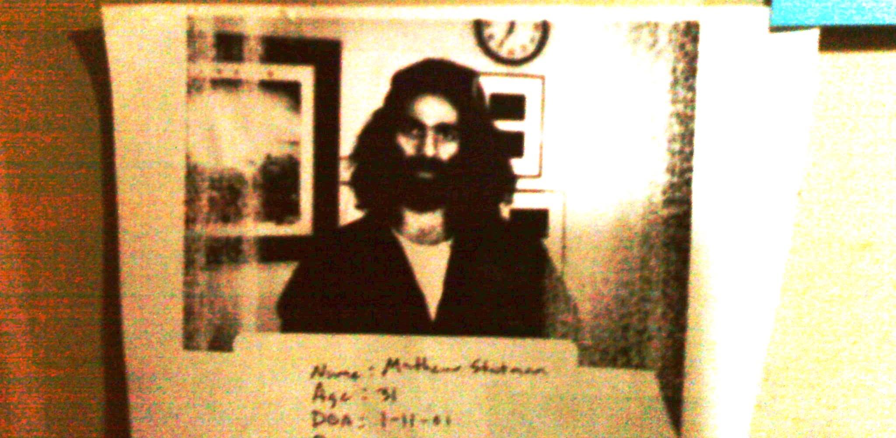

Slide 8
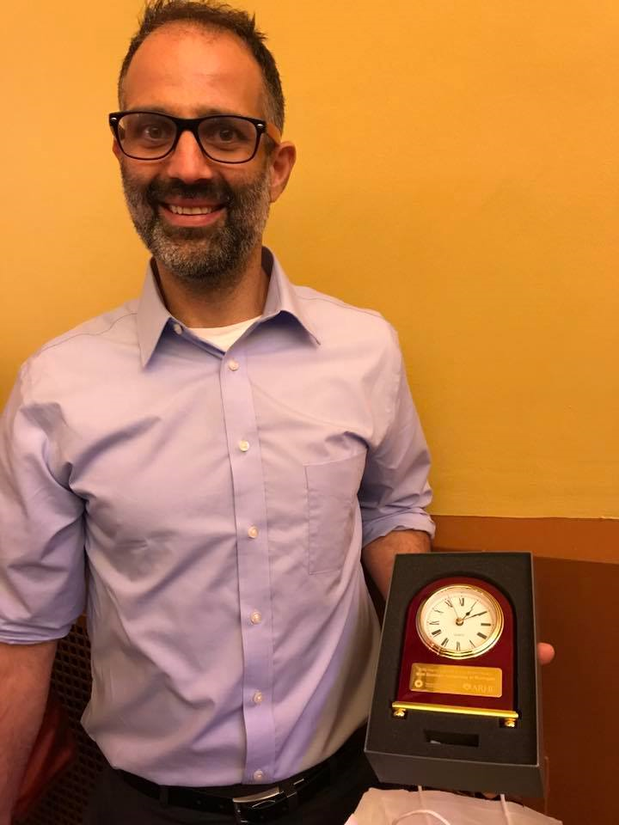

Slide 9
Ambivalence
Is normal
Feeling two ways about something is not pathological
Empathy
Think about something that you’re on the fence about
Part of you wants to, and part of you doesn’t

Slide 10
Ambivalence
The starting point
If we start to try to convince, we end up pushing in the opposite direction
Entrenchment in the status quo

Slide 11
Motivational Interviewing
Anyone working w/ precontemplative or contemplative people
TRAINING
(no, this quick 30 minutes is not going to be sufficient)

Slide 12
MI
OARS
Open-ended questions
Affirmations
Reflections
Summaries

Slide 13
Open-ended Questions
“What have you tried?”
“What are your ideas about what to do next?”
“How might you do it?”
“Tell me about”
Elicit

Slide 14
Affirmations
“This is really important to you”
When was the last time that you heard something affirming?
Catch me doing the right thing
Identify strengths
Rapport, empathy
(not praise)

Slide 15
Reflections
“You’re really worried about this”
Simple
Complex
Feeling
Meaning
Double-sided
I’m listening & trying to understand

Slide 16
Summaries
“Last week we talked about”
“Let me make sure that I’ve got this right”
Begin, end, transition
Putting it all together

Slide 17
“If you act like you have five minutes, it’ll take all day.
But if you act like you have all day, it’ll take five minutes.”

Slide 18
MI Spirit
CAPE
Compassion
Acceptance
Partnership
Evocation

Slide 19
Compassion
Goal is to convey empathy
Trying to understand
Non judgemental
From their perspective

Slide 20
Acceptance
4 As
Absolute worth
Autonomy
Accurate empathy
Affirmation

Slide 21
Partnership
Collaboration
Flat hierarchy
Respect

Slide 22
Evocation
Client/patient reasons for change
Motivation is elicited (our job)
OARS
Who talks more?

Slide 23
Rulers
Importance
Confidence
Influences where we go next
“Why not a”
“What would it take to”
What were you on the fence about?

Slide 24
Recovery Capital
Internal & external
Strengths & resources
Biopsychosocial

Slide 25
BPS
Bio
physical health, detox/withdrawal, medications
ASAM dimension 1 (withdrawal potential) & 2 (biomedical complications)
Psych
emotional regulation, coping skills, recovery planning, ACES
ASAM dimensions 3 (emotional/cognitive) & 4 (readiness) & 5 (relapse potential)
Social
peers, housing, employment, education, social support
ASAM dimensions 6 (social and environmental factors)

Slide 26
Strengths & Needs
Bio
Psych
Social
What information is important?
What questions should we ask?

Slide 27
MI Sandwich
Build rapport
Collect information
Summarize and reconnect
Making LOC determinations (after lunch)

Slide 28
Therapeutic Alliance
Client/patient perception
Especially in early stages of change
Improves outcomes
Maintains engagement
Might be the MOST important factor in positive outcome
The relationship
Do you genuinely care about me?
Do you genuinely believe in my ability to get better?

Slide 29
Wrap Up
Questions?
Anna Byberg, LMSW, CAADC
abyberg@dawnfarm.org
734-669-8265

