Slide 1
Opioid Maintenance Treatment (OMT)
Edward A. Jouney, DO, MS
University of Michigan, Department of Psychiatry

Slide 2
Heroin
Is diacetylmorphine
Classified as a Schedule 1 drug (not available for any therapeutic use in the United States).
Synthetically derived from the natural opioid, morphine.
First synthesized in the 1870’s by the Bayer Company, and marketed under the name “heroin.”
The rapid onset of action and very short half life make it a popular drug of abuse.

Slide 3
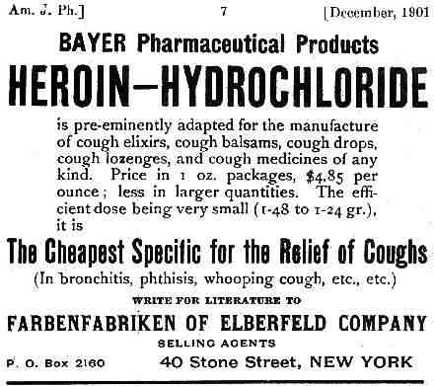
Heroin Advertisement

Slide 4
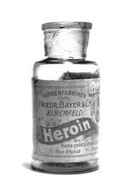
Bottle of Heroin

Slide 5
Heroin Pharmacology
Heroin is intravenously, intra-nasally, and smoked in the free-base form.
Is a prodrug: i.e., it is has no bioactivity as is.
Is rapidly deacetylated to 6-mono-acetylmorphine (6MAM) and morphine, which are both active at the mu receptor.

Slide 6
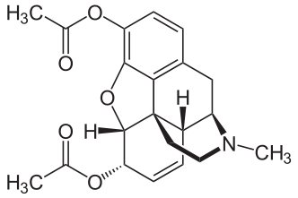
Heroin

Slide 7
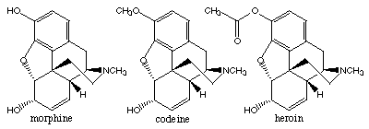
Chemical Structures
Heroin, Morphine, and Codeine

Slide 8
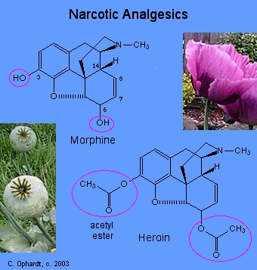
Morphine and Heroin Structures

Slide 9
Opioids - Definitions
Opioids: all compounds, natural, semi-synthetic and synthetic, that act on the mu opioid receptor.
Opiates: drugs derived or synthesized from the the natural occurring compounds in opium.
Examples:
Methadone is a synthetic opioid.
Codeine, morphine, and heroin or opiates.
All or under the classification of opiods.

Slide 10
Opioid use disorder – criteria
A problematic pattern of opioid use leading to clinically significant impairment or distress, as manifested by at least two of the following, occurring within a 12-month period:
1. Opioids are often taken in larger amounts or over a longer period than was intended.
2. There is a persistent desire or unsuccessful efforts to cut down or control opioid use.
3. A great deal of time is spent in activities necessary to obtain the opioid, use the opioid, or recover from its effects.
4. Craving, or a strong desire or urge to use opioids.
5. Recurrent opioid use resulting in a failure to fulfill major role obligations at work, school, or home.

Slide 11
Opioid use disorder – criteria
6. Continued opioid use despite having persistent or recurrent social or interpersonal problems caused or exacerbated by the effects of opioids.
7. Important social, occupational, or recreational activities are given up or reduced because of opioid use.
8. Recurrent opioid use in situations in which it is physically hazardous.
9. Continued opioid use despite knowledge of having a persistent or recurrent physical or psychological problem that is likely to have been caused or exacerbated by the substance.
10. Tolerance (not met it taking opioids under appropriate medical supervision).
11. Withdrawal (not met it taking opioids under appropriate medical supervision).

Slide 12
Opioid use disorders – criteria
305.50 (F11.10) Mild: Presence of 2–3 symptoms
304.00 (F11.20) Moderate: Presence of 4–5 symptoms.
304.00 (F11.20) Severe: Presence of 6 or more symptoms.

Slide 13
Historical Background
Use of opioids as maintenance pharmacotherapy began in the 1960’s with the use of methadone by Dole and Nyswander
Currently, the FDA has approved two drugs for the opioid maintenance therapy in the treatment of opioid addiction: methadone and buprenorphine
Methadone
Subutex (buprenorphine)
Suboxone (buprenorphine/naloxone)

Slide 14
A Poorly Understood Treatment (OMT)
OMT continues to be poorly understood my health care professionals, including basic treatment concepts and general pharmacological concepts of methadone and buprenorphine.
Negative attitudes and stigmatization amongst health care workers and the general public plague OMT.
Many have the concept that one is “substituting one addicting drug for another.”
Methadone treatment remains separated from the mainstream of health care delivery, and is isolated in its own little world.

Slide 15
Methadone
Is a synthetic, long acting, full mu opioid agonist
First synthesized by Bayer as an analgesic in German in the 1930’s
First studied for human use in the 1950’s in the United States.
First researched as a treatment for heroin addiction in 1964.
Approved by the FDA as a maintenance therapy for opioid addiction in 1972.

Slide 16
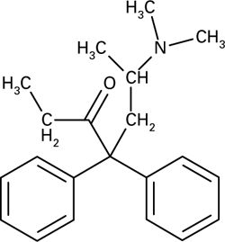
Methadone: Chemical Structure

Slide 17
Buprenorphine
Branded under Suboxone, Zubsolv, Bunavail, others
Approved by the FDA as a treatment for opioid dependence in 2002.
Is a synthetic opioid
Functions as a partial mu receptor agonist.
Has a “ceiling” effect: there is a plateau to the maximum effect, regardless of increasing the dose (in contrast to a full agonist).
Is approved for “office-based” opioid maintenance.

Slide 18
Buprenorphine
Thebaine derivative
μ-partial agonist κ-antagonist
High affinity μ receptor > most agonists
Slow dissociation - long T1/2 at receptor
CYP P450—3A4 minimal d/d interactions
Norbuprenorphine—Active Metabolite
Biliary (70%) and Urinary (30%) Excret.
Hemodialysis safe

Slide 19
Buprenorpine
2002: FDA approved 2 medications for treating opioid dependence, DEA scheduled III narcotic– Sublingual tablets: Buprenorphine (Subutex ®) Buprenorphine/naloxone (Suboxone ®)
Individually wrapped pouches that are child-resistant
implants (Ling W et al. JAMA 2010) Not yet FDA approved – To improve adherence and decrease diversion
Parenteral forms (Buprenex) and transdermal patch (Butrans) are FDA approved for pain, NOT ADDICTION.

Slide 20
Why OMT?
OMT provides a stabilization or correction of a possible “lesion” or defect in the endogenous opioid system. This is in theory, and the neurobiological mechanism remains poorly understood.
Target outcomes of OMT
Reduces opioid cravings.
Prevents opioid withdrawal.
Reduces likelihood of IV drug use.
Diminishes preoccupation of drug seeking thoughts.
Reduces criminal behaviors.

Slide 21
Impact of Maintenance Treatment
Reduction death rates (Grondblah, ’90)
Reduction IVDU (Ball & Ross, ‘91)
Reduction crime days (Ball & Ross)
Reduction rate of HIV seroconversion (Bourne, ‘88;Novick ‘90,; Metzger ’93)
Reduction relapse to IVDU (Ball & Ross)
Improved employment, health, & social function

Slide 22
Goals of Pharmacotherapy
Prevention or reduction of withdrawal symptoms
Prevention or reduction of drug craving
Prevention of relapse to use of addictive drug
Restoration to or toward normalcy of any physiological function disrupted by drug abuse
Rehabilitation/Recovery

Slide 23
Methadone
Used primarily for the management of heroin addiction until the late 1990s.
Has become one of the most widely prescribed opioid painkillers, with 4 million prescriptions written for pain relief in 2006 alone.
One of the most deadly drugs around, the report from the CDC’s National Center for Health Statistics (NCHS) confirms.
The number of poisoning deaths involving methadone increased from 790 to 5,420 from 1999 to 2006.

Slide 24
Methadone OMT Admission Criteria
Current addiction - diagnosis by DSM-IV
One year history of addiction
Determined by medical/other records (criminal justice, previous treatment, etc.)
Exemptions from One Year criteria: Pregnant patients, release from penal institution, previous treatment.
For maintenance treatment (under 18 YOA) – 2 documented unsuccessful attempts at short term detox, or drug free w/in 12 months. – Consent from parent/guardian before admission.

Slide 25
Methadone Side-Effects
Minimal sedation once tolerance achieved
Excessive Sweating
Constipation
Increased Appetite/Weight Gain
Lowered Libido; May decrease gonadal hormone levels—testosterone
QTc prolongation
Exhaustively studied in all other organ systems with no evidence of chronic harm
Hemodialysis safe

Slide 26
Methadone Dosing
Is once daily, in OMT: most patients require 80 – 120mg qd.
For analgesia, methadone is dosed TID, since the analgesic effect of the drug lasts only 6-8 hours (NOTE: elimination half-life is 24-36 hours).
Be weary of drug accumulation, due to long half-life, which can result in toxicity and possibly death.

Slide 27
Methadone Dosing
Induction and stabilization phase
By federal regulations, the first dose is no more than 30mg, and is not to exceed 40mg on the first treatment day.
Note: serum levels rise despite NO increase in daily dose during the induction phase, due to the long half-life of the drug.
Rate of increase levels off after 4-5 half-lives, at which point, steady stated kinetics is achieved.
Dosage can be increased in 5 to 10mg increments every 3-7 days.
NOTE: Many deaths have occurred during the induction phase of methadone maintenance.

Slide 28
Special Considerations
Hospital admissions: Methadone doses should always be verified upon hospital admission, before an order is written.
Pregnancy: Methadone has long been the “gold standard” for opioid dependent pregnant population.
Buprenorphine is becoming increasingly used and gaining widespread acceptance.
Pain: do NOT assume that the patient on methadone maintenance does not analgesic management in acute situations.
Pain should be treated accordingly and not ignored.

Slide 29
“72 HOUR RULE” 21 CFR §1306.07
“Nothing in this section shall prohibit a physician who is not specifically registered to conduct an OTP from administering (but not prescribing) narcotic drugs to a person for the purpose of relieving acute withdrawal symptoms when necessary while arrangements are being made for referral for treatment. Not more than one day’s medication may be administered to the person or for the person’s use at one time. Such emergency treatment may be carried out for not more than three days and may not be renewed or extended.”

Slide 30
Methadone and BZD
Prevalence of 47% lifetime use of BZD among our methadone-maintained patients and most of whom used BZD without a prescription (39.8%).
main reasons for using BZD without a prescription are curiosity (46%), relieving tension or anxiety (41%) and feeling good (37%).
Half (54%) did not use BZD until after they entered into methadone program, and 61% of previous BZD users reported increased use.

Slide 31
Methadone and BZD
Most methadone programs do not address co-occurring anxiety problems, and methadone treatment may trigger onset or worsening of BZD misuse.
Individuals are more likely to experience elevated anxiety after stopping use of opiates, with increased risk of using BZD as an anxiety coping strategy.
Individuals who abuse BZD are at increased risk of continuing opiate abuse and failing to stay in methadone treatment.

Slide 32
Naltrexone
Extinction paradigm—patients will cease use if drug pleasurable effects blocked
Craving decreases when heroin “not available”
?Naltrexone decreases cue-induced craving and priming-induced craving

Slide 33
Naltrexone Pharmacokinetics
Rapidly absorbed
Rapidly transformed to an active metabolite, 6-beta naltrexol
Peak Plasma levels in 1 hr. 10:1 ratio of metabolite:parent
T 1⁄2 =4 hrs for naltrexone =12 hrs for 6-beta-naltrexol
Usual dose=50 mg qd
I.M. naltrexone (Vivitrol) 380 mg every 28 days.

Slide 34
Naltrexone
Effective in specialized populations, such as impaired professionals
Low attraction in general in traditional OTPs compared to other therapies
Early drop out is common
50 mg. QD--rare LFT elevations at this dose

Slide 35
Thank you
Email: ejouney@med.umich.edu

